Slide 1
Cost Per Lead Program
A Proven Road to Success
Jay Brookes
VP of Sales, Laser Image
717-830-7033
jay.brookes@laser2mail.com

Slide 2
Per Lead vs Mail by 1000
Per Lead
We Assume The Response Rate Risk
We estimate how many leads are available in a county/zip codes
You only pay a price per lead
Plan your lead budget with accuracy
We use the most sophisticated list modeling and demographic systems available in the industry today to accomplish this
Various lead pieces are available
Per Mail
You Take All The Response Rate Risk
You select the lead piece
You select the demographic profile
You pay for the mail on a per thousand mail piece basis.
You accept the returns, 1.3%, 1.7%, 2.3% ???
You plan your prospecting based on ???
One bad mailing (poor returns) can put you and your agency out of business for weeks!

Slide 3
Why Order Per Lead
Medicare Planned Production
Knowing how many leads you are purchasing you will be able to predict your workflow and consequently your production potential
Example:
50 Leads @ $22 per lead = $1,100 cost
50 Leads = 25 appointments
25 appointments = 12.5 sales x $1500 = $18,750 annualized premium
Average Medicare premium, or equivalent, $1,500
Return on investment = Your commission rate x $18,750 premium
In today’s complicated world of insurance selling all that is required of you is to receive your leads and go to work.

Slide 4
How It Works…

Slide 5
How It Works
You chose the area you want to work in
Choose by county sectional center or zip codes
We will tell you how many leads can be produced in that area (Not all areas are available)
You choose from our lead menu which lead piece you want to use

Slide 6
How It Works
We quote you the price based on the type of lead selected and the number of leads we can produce available in the area (Minimum order 50 leads, $1,000)*
You will be informed on when to expect your first leads
When your leads arrive you go to work selling, knowing how many prospects you will be working
*A matured lead order is the responses received 90 days after order date. A refund will be generated for any portion of the number of leads order which were not received.

Slide 7
Example of Per Lead Counts Tulsa, OK Area
Tulsa
County | Count | Qty Leads
Adair | 644 | 13
Cherokee | 1,846 | 37
Craig | 741 | 15
Delaware | 1,941 | 39
Haskell | 519 | 10
Kay | 2,016 | 40
Latimer | 443 | 9
Le Flore | 2,050 | 41
Mcintosh | 1,167 | 23
Mayes | 1,529 | 31
Muskogee | 2,508 | 50
Nowata | 303 | 6
Osage | 1,735 | 35
Ottawa | 1,447 | 29
Pittsburg | 1,804 | 36
Rogers | 2,830 | 57
Sequoyah | 1,638 | 33
Tulsa | 16,029 | 321
Wagoner | 2,272 | 45
Washington | 1,982 | 40
Total | 45,444 | 909
(Demographics include Medicare dual eligible and supplement eligible)

Slide 8
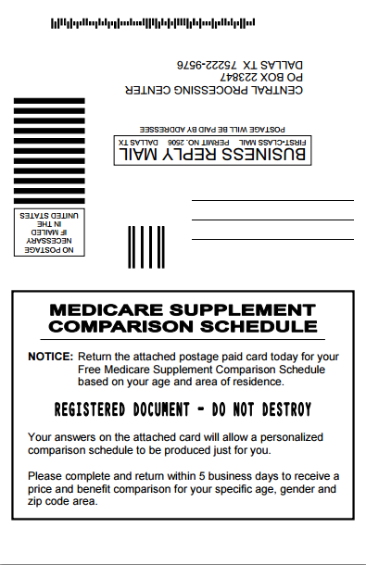
2015 Medicare Supplement Comparison Lead

Slide 9
2015 Medicare Health Plans Update (no booklet lead)

Slide 10
2015 Medicare Health Plans Update (booklet lead)

Slide 11
Per Lead Program Available in These States
Alaska
Alabama
Arkansas
Colorado
Connecticut
Georgia
Hawaii
Illinois
Indiana
Kentucky
Louisiana
Maryland
Michigan
Minnesota
Missouri
Mississippi
Montana
North Carolina
Nebraska
Ohio
Oklahoma
Pennsylvania
South Carolina
Tennessee
Virginia

Slide 12
The Per Lead Prospecting System
The technical systems, mailing equipment, list partners and agent lead management, are the state of the art available in the industry today.

Slide 13
Cost Per Lead Program
A Proven Road to Success
Jay Brookes
VP of Sales, Laser Image
717-830-7033
jay.brookes@laser2mail.com

