Slide 1
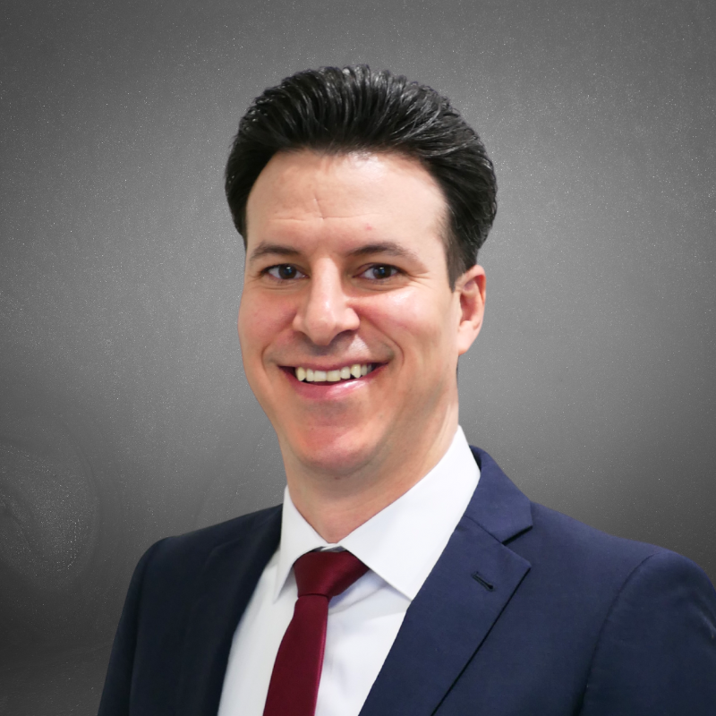


GREG SEGOVIA III
Ins and Outs of an FMO Relationship
WWW.PSMBROKERAGE.COM
For Agent Use Only

Slide 2


So what is an FMO?
  So many acronyms...??
    FMO / IMO / NMO / TMO
  Wholesale Distribution Partner w/ Insurance Carrier
    Recruit, Educate, Train, Develop, Support Independent Agents and Agencies
    => Producing => Achieve Goals => Success!
  So much more than that...

Slide 3

So what is an FMO?
Foundational Pillars:
  Portfolio of Carriers / Products
  Infrastructure – Internal & External
  Tools / Resources / Platforms
  Relationships – Carriers / Vendors / Industry Experts
  Support => Catered Support

Slide 4

What’s Next
  Interview and Inquire – FMO Vetting Process
    Mimic real world qualification process
    Choose the right business partner!
  Things to consider...
    What questions do I ask?
    Is there an FMO checklist?

Slide 5

Carriers - Products - Hierarchal Food Chain
  Robust Portfolio
  Position in Hierarchy
    Top Contracts
    Carrier Relationships

Slide 6
FMO Infrastructure - Internal
  Tenured & Experienced
  Family Atmosphere & Culture
  Staff & Administration
  Internal Infrastructure:
    Systems, Specialty Departments, Locality
  Resourceful / Efficient / Accountable / Available

Slide 7

FMO Infrastructure – External Tools / Resources / Platforms
  E-Contracting
  Quoting / Enrollment Platforms
  CRM / Data Management
  Product / Sales Training
  Business Building Resources
  Evolving Technology

Slide 8

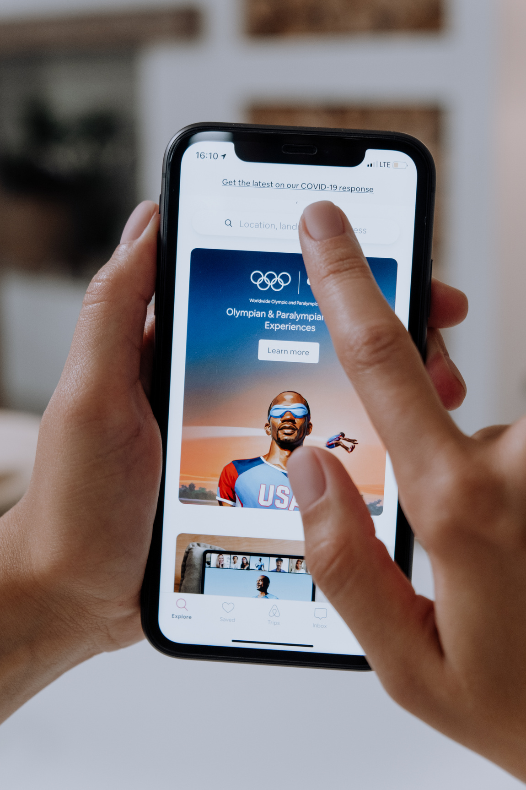


Important Relationships
  Carriers / Reps
  Vendors
    Leads
    Marketing
    Business Mgmt.
  Industry Experts

Slide 9

Steadfast Support
  1-on-1 Mentorship => Dedicated Support Post (feel like on an island)
  Business Building Aspects:
    Leads
    Marketing
    Compliance
    Educational Guides

Slide 10

Steadfast Support
  Reinvesting back in your business:
    Co-Op
    Reimbursements
  Communication / Updates
  Catered Support Approach
    All shapes / sizes and needs!

Slide 11
Additional Considerations
  Proprietary / Exclusive Offerings
  Verticals of Specialty
  Health Insurance Available
  Acquisition Strategies / Capabilities
  Release Protocol – Open Release?

Slide 12
Overall FMO-Agent Relationship
  Synergy
  Symbiotic
  Vested Partnership
  Family-Oriented

Slide 13
Overall FMO-Agent Relationship
  Synergy
  Symbiotic
  Vested Partnership
  Family-Oriented
This is how the RELATIONSHIP with your FMO should be!

Slide 14



THANK YOU
For Your Attendence
WWW.PSMBROKERAGE.COM
For Agent Use Only

